Slide 1
Water in the World
Types of water

Slide 2
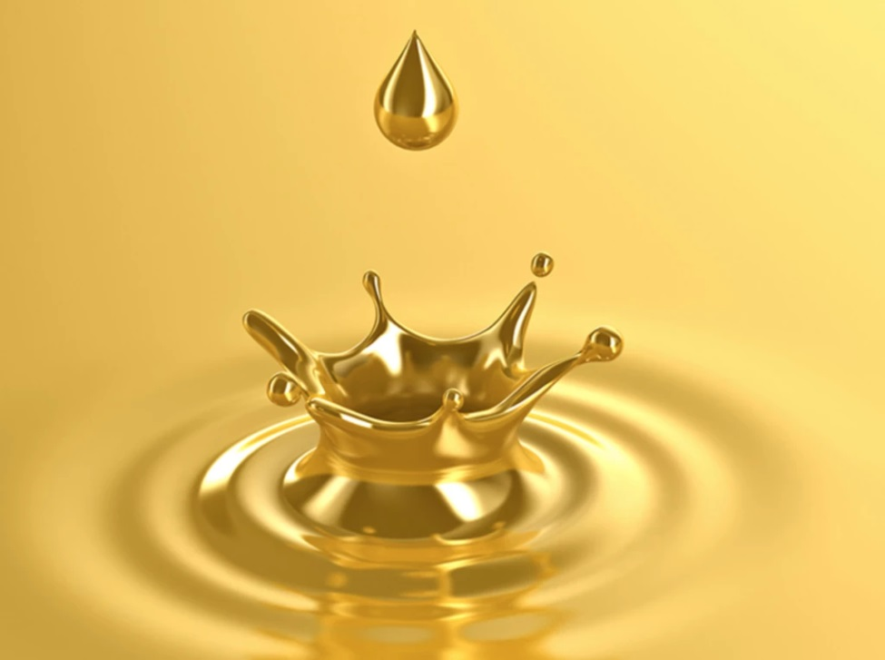
What do we use water for?
Make a list of as many uses as you possibly can.
Class whiteboard share

Slide 3
Survey
Do you leave the tap on when brushing your teeth
Does your family wash their car on the grass?
Do you buy bottled water?
How much water do you drink a day?
Do you use a bath or shower?
If it's yellow do you let it mellow?
Do you hand wash dishes or use a dishwasher?
Do you have a water tank?
Do you have a swimming pool/spa/fish tank?

Slide 4
Water footprint calculator
https://waterfootprint.org/en/resources/interactive-tools/personal-water-footprint-calculator/

Slide 5
https://thewaterweeat.com/
Scroll through the website to discover how much water is in the food that we eat!

Slide 6
Reducing water use
Copy the table into your book
Identify and list actions that you and your family could take to reduce water.
Rooms | Actions to save water
Bathroom
Toilet
Kitchen
Laundry
Garden
Outdoor area
Spa/pool
Living area

Slide 7
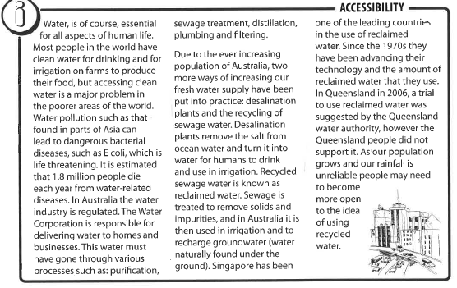
Accessibility- Text

Slide 8
Check for understanding
1. Ocean water can be converted to drinking water T/F
2. Australia has problems with bacteria in its water T/F
3. Reclaimed or recycled water uses sewage water T/F
4. Water in solid form is called liquid T/F
5. Purification, plumbing and filtering all treat water T/F

Slide 9
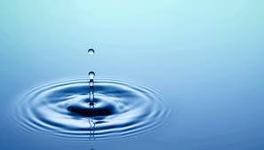
How much water is there?
Water covers about 75% of the Earth’s surface
97.5% of this is unusable salt water
Of the remaining 2.5% that is fresh water:
69.5% is trapped in glaciers
30.1% is found in ground water
That leaves 0.4% available to humans for use?!?!?!

Slide 10
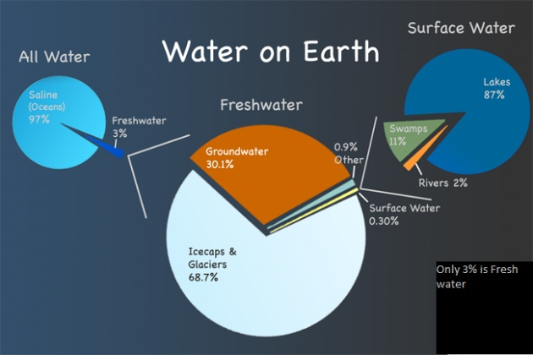

Slide 11
Ground water
Ground water is found under the Earth’s surface, it has seeped into it from rainfall
It is held between water bearing rocks called aquifers.
If water is held in impermeable rocks it is called an artisan aquifer

Slide 12
Ground water
Ground water can be fresh enough to drink or saltier than the ocean
It is used around the world for
Drinking (bottled water)
Gardens (bore water)
Industry
Ground water is slow to replenish and as such is considered a finite resource
Notes:
Get students to draw an X on their page.

Slide 13
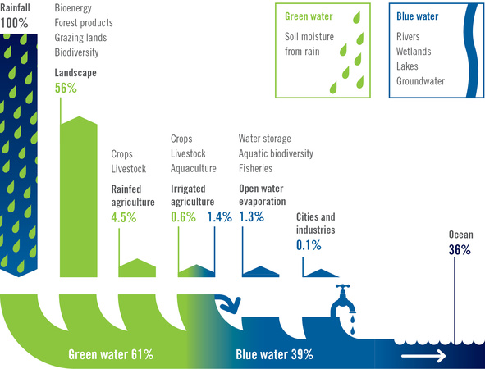
Blue and green water
Blue water is fresh surface water and ground water
Green water does not run into streams but instead stays on the surface of the soil and vegetation
Notes:
Show what an aquifer is
Finite but renewable.

Slide 14
Grey water
Grey water can be defined as any domestic wastewater produced, excluding sewage ie: washing up water, washing machine water, shower or bath water
With proper treatment greywater can be put to good use. These uses include water for laundry and toilet flushing, and also irrigation of plants. The nutrients in the greywater (such as phosphorus and nitrogen) provide an excellent food source for these plants

Slide 15
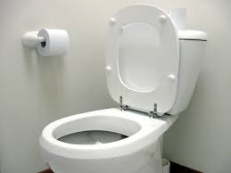
Black water
Blackwater is used to describe wastewater containing faeces, urine and flush water from flush toilets

Slide 16
Recycling water
It is considered more economical and environmental to recycle black water because current plumbing systems don’t separate grey and black water
It reduces water use by 90%

Slide 17
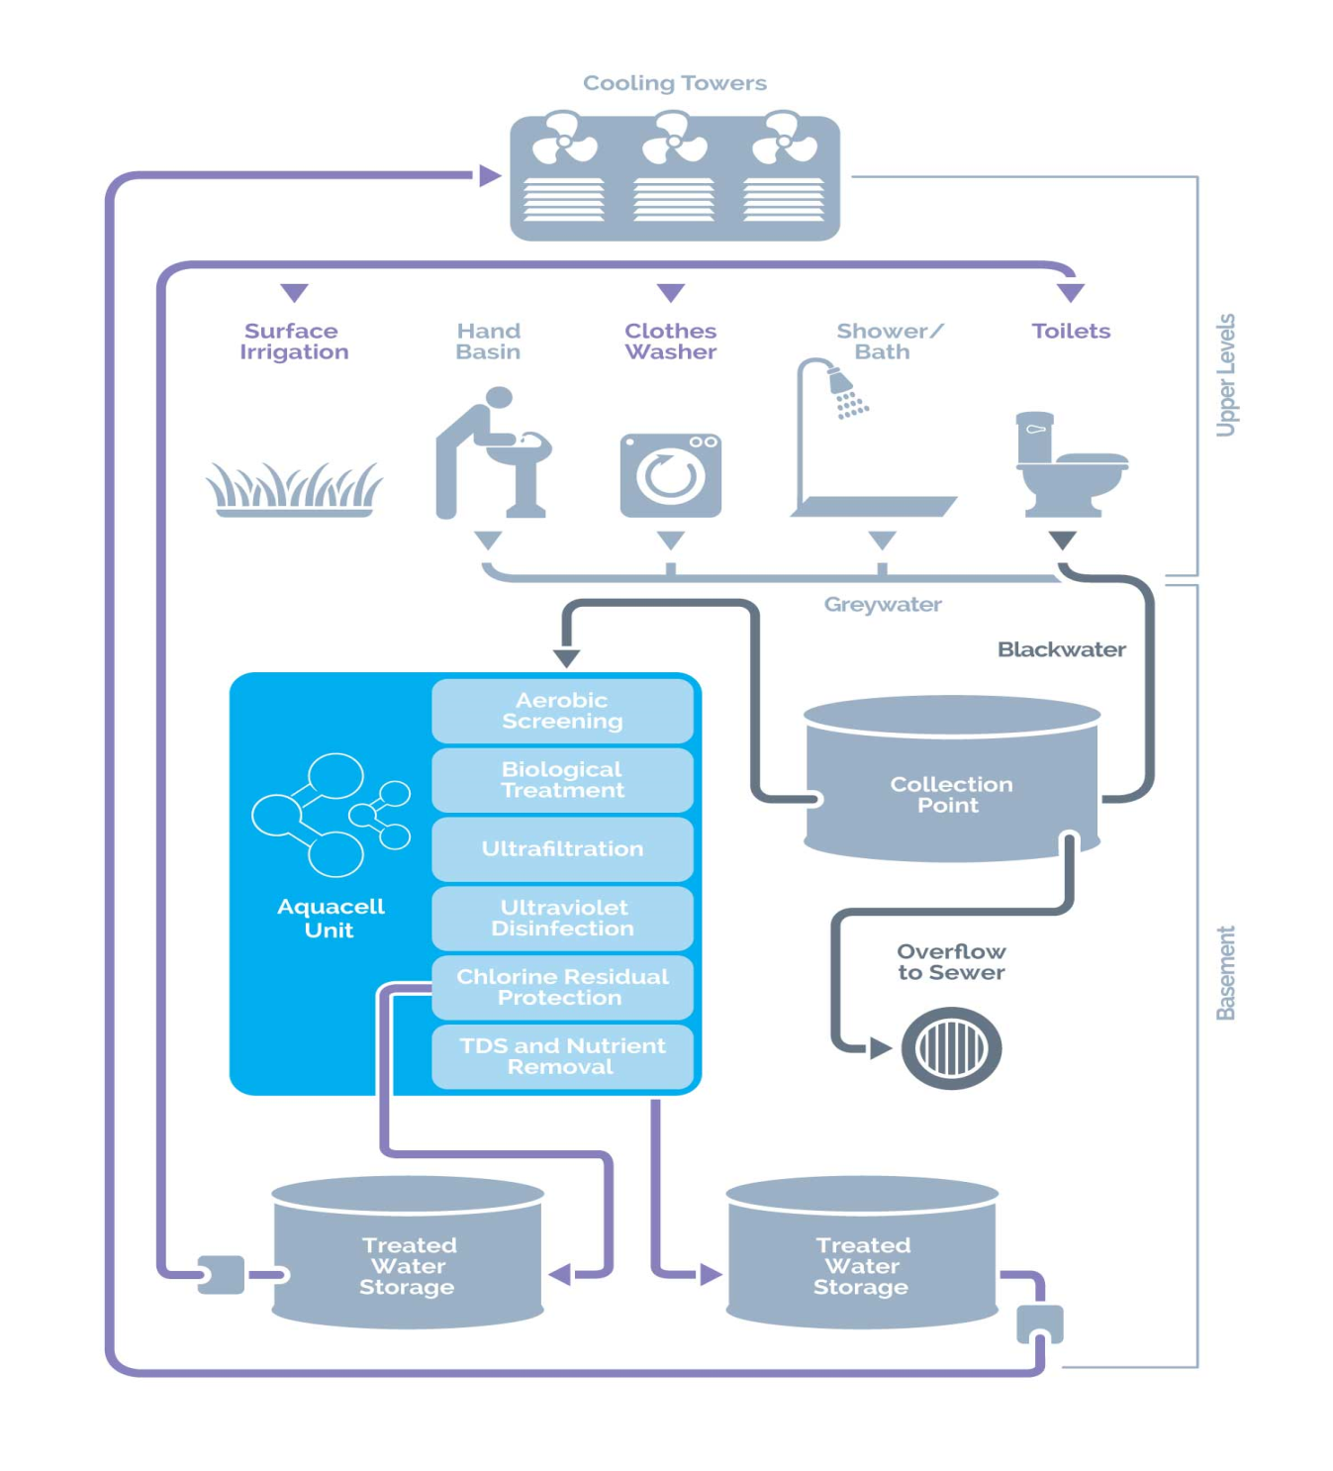

Slide 18
Virtual water
Also known as
Hidden water
Embedded water
This is the water that goes into producing goods and services ie:
Growing crops
Running industrial machines

Slide 19
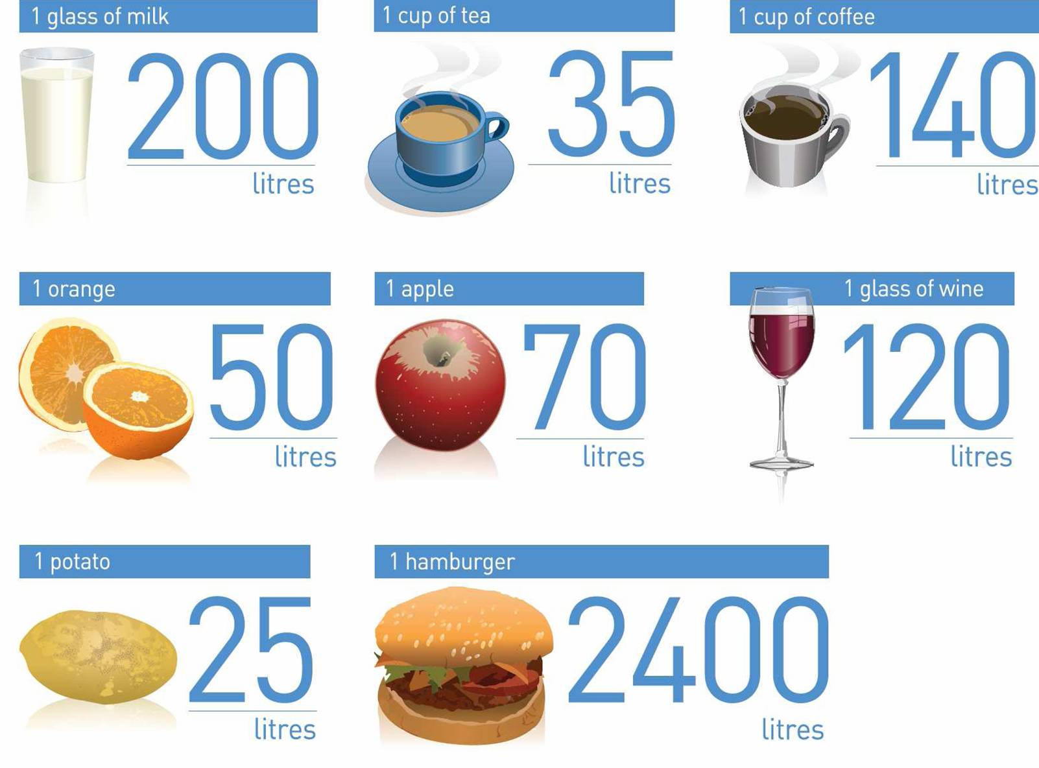

Slide 20
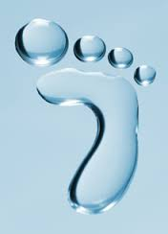
Water footprint
Water footprint is the total volume of fresh water that is used by a country or individual
For a country there are two parts:
Use of domestic water
Amount of virtual water imported

